Slide 1
Lecture 1 Introduction to Statistical Methods

Slide 2
Answering Questions with data
What proportion of people in the U.S are biologically female?
Survey Americans and ask them to report their sex
Does a low-carb diet result in significant weight loss?
- Design an experiment to evaluate the effectiveness of the low carb diet on weight loss
- Record information such as starting and ending weight, calories consumed per day, …
Are people more likely to stop at Starbucks if they’ve recently seen a Starbucks TV add?
Conduct a marketing survey to record the number of people who have gone to starbucks since add aired
Compare between those who saw the add and those who did not

Slide 3

Where do we find Statistics? – Everywhere!
Sports (number of points scored per game by an athlete)
Weather Forecasting (average monthly rainfall)
Economy (median income, unemployment rate)
Sales Tracking (projected sales revenue from iphone 14’s sold in a given month)
Medicine (percentage of people who were pain free from using a drug)
Manufacturing (number of cans of coke produced in a given month)
The science of statistics deals with the collection, analysis, interpretation, and presentation of data
Data is a collection of observations/measurements

Slide 4
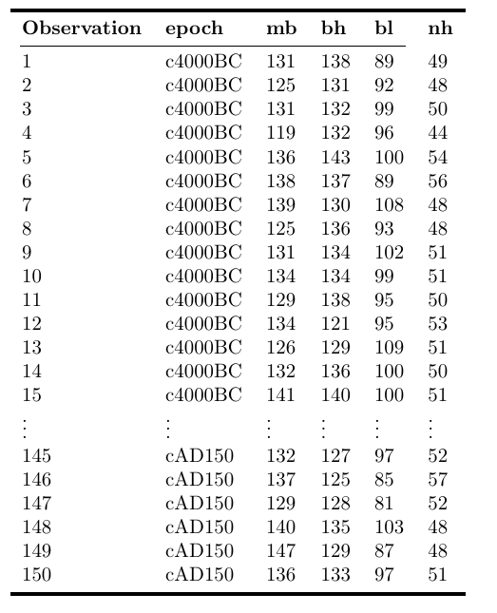
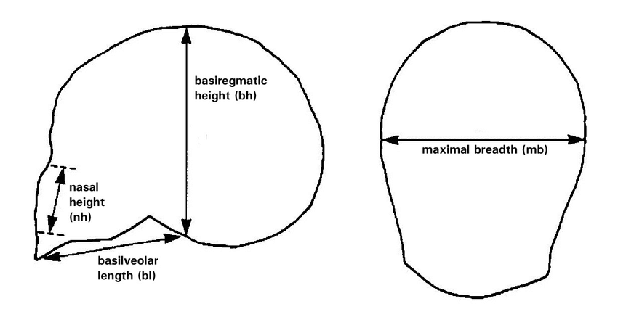
What Do Data Look Like?
The following are data from an analysis of 150 Egyptian skulls from 5 epochs of Egyptian history. For each skull, the epoch, and several measurements characterizing the shape of the skull are recorded
Source: D. J. Hand, F. Daly, A. D. Lunn, K. J. McConway and E. Ostrowski (1994). A Handbook of Small Datasets, Chapman and Hall/CRC, London.
Visualizing Tests for Equality of Covariance Matrices - Scientific Figure on ResearchGate. Available from: https://www.researchgate.net/figure/Diagram-of-the-skull-measurements-for-the-Egyptian-skulls-data-set-Maximal-breadth-and_fig4_325126938 [accessed 21 Aug, 2023]

Slide 5
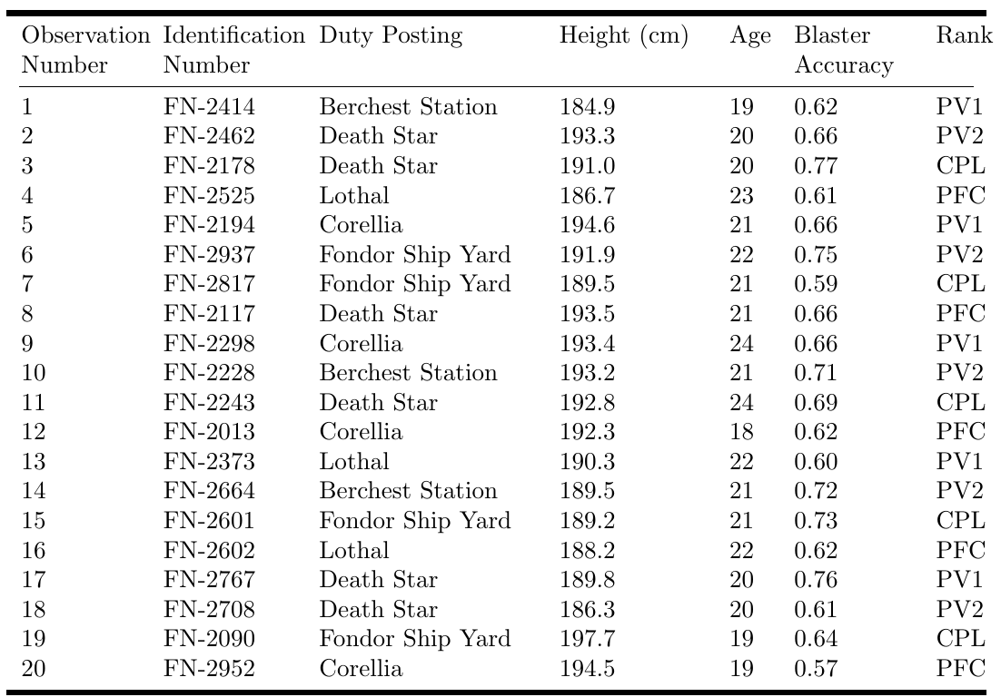

Example Data 2
The following table contains fictional data consisting of 20 observations of storm troopers who have just graduated from the Empire’s Imperial Academy. The height, age, blaster accuracy, and future duty posting are recorded for each storm trooper
This Photo by Unknown Author is licensed under CC BY-NC-ND

Slide 6
Checkpoint:
Data - a collection of observations/measurements on a set of variables - typically represented as a table.
Observation – the fundamental unit of data – typically observations are rows of a data table
Variables – characteristics of an observation – typically variables are the columns of a data table

Slide 7
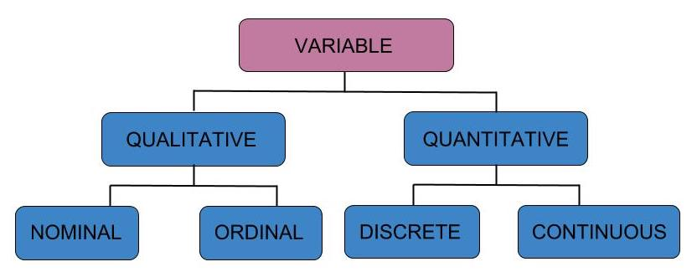
Types of Variables: Qualitative vs Quantitative

Slide 8

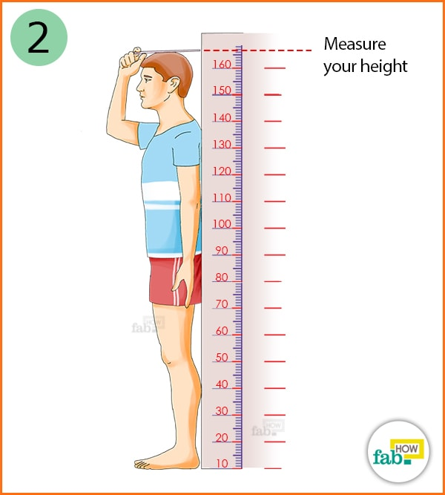
Types of Variables: Qualitative vs Quantitative
Qualitative (Categorical) variable – non-numeric qualities or characteristics that can be placed in distinct categories
State/city (ID, WA, MT, ...)
Treatment (Drug/Placebo)
Genotype (AA, AT, TT)
Survival (live or die)
Quantitative (numeric) variable – numerical characteristics - can be ordered or ranked
Height (inches/cm)
Weight (lbs/kg)
Longevity/Age (number of years)
Dose (micrograms per gram)

Slide 9

Practice: Qualitative vs Quantitative
From our example data of egyptian skulls, which variables are qualitative and which are quantitative?
Qualitative: Epoch
Quantitative: mb, bh, bl, nh

Slide 10
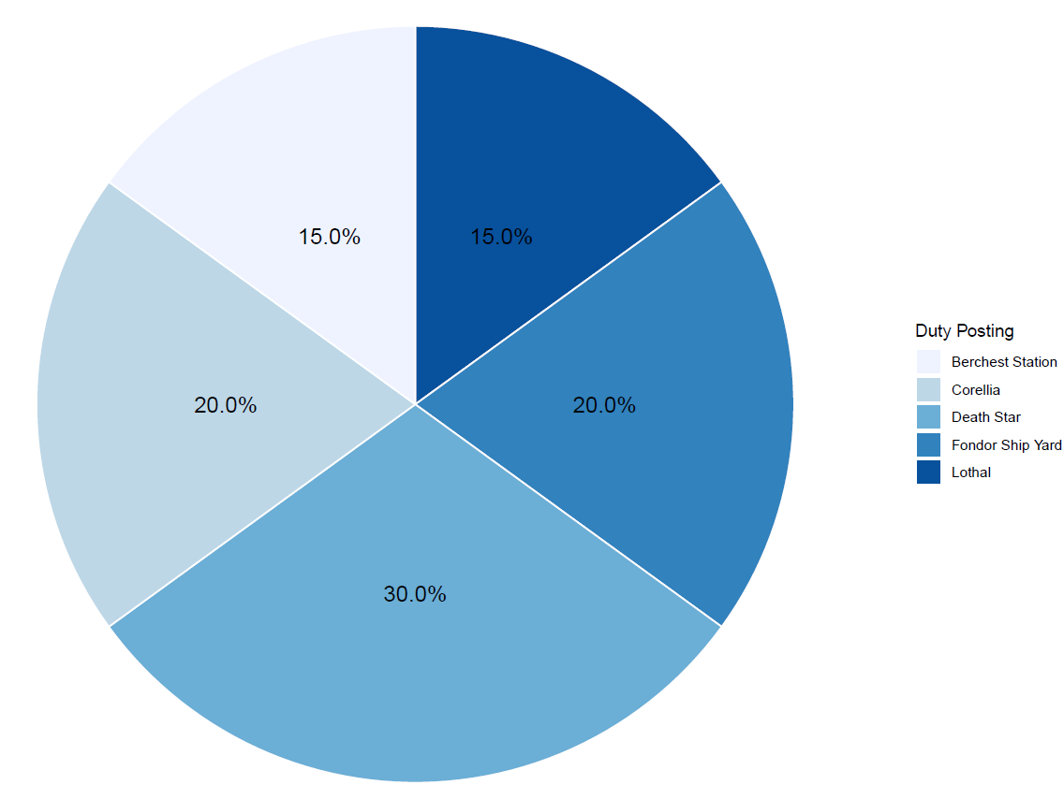
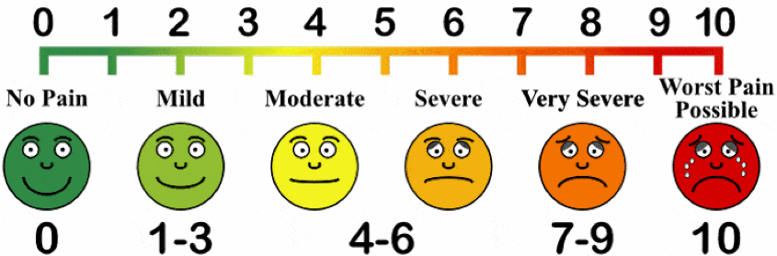
Types of Variables: Qualitative vs Quantitative
Qualitative nominal – non-numeric qualities or characteristics that can be placed in distinct categories that do not have a natural ordering (e.g labels, names, colors, etc)
Qualitative ordinal – non-numeric qualities or characteristics that can be placed in distinct categories with an inherent ordering (Likert responses, education level, military ranking)
This Photo by Unknown Author is licensed under CC BY-NC-ND

Slide 11
Practice: Qualitative vs Quantitative
In the stormtrooper example data, which variable(s) are qualitative nominal and which are qualitative ordinal?
Qualitative nominal: ID Number, Duty Posting
Qualitative ordinal: Rank

Slide 12
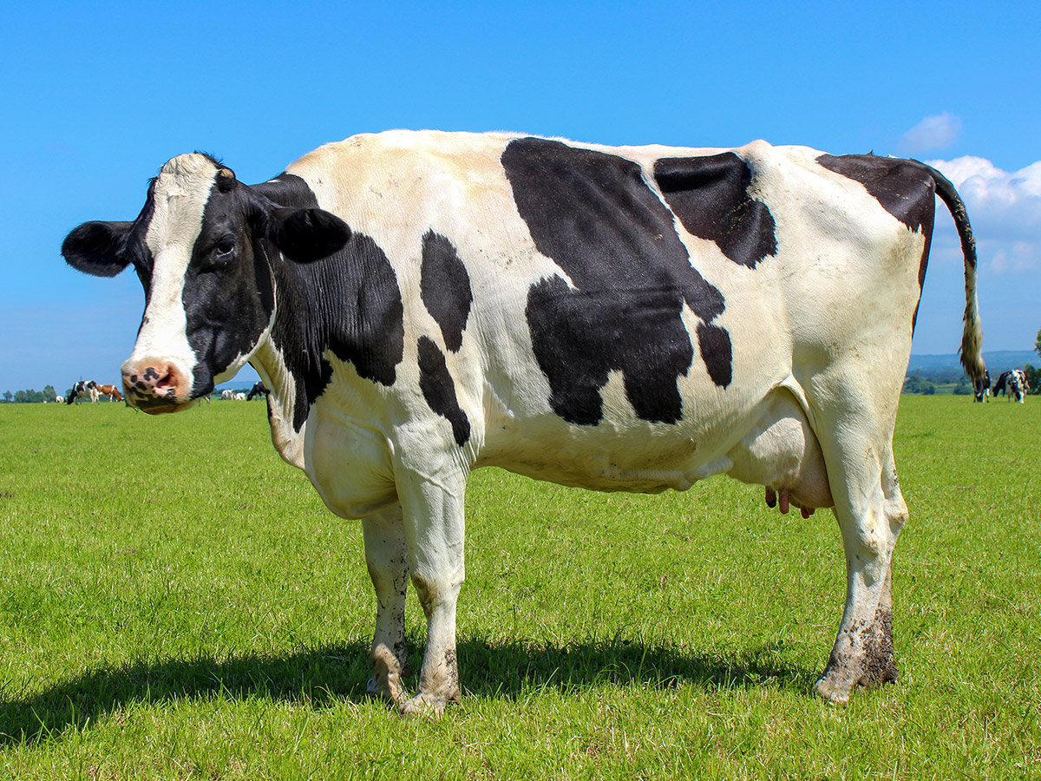


Quantitative Variables: Discrete vs Continuous
Quantitative discrete – quantitative variables that take on distinct, countable values such 0,1,2,3… (whole numbers or integers)
- all counts are quantitative discrete variables
Quantitative continuous – variables that can take on infinite number of values within an interval of any two specific values (e.g temperature ◦F, height in inches, speed in miles per hour)
e.g. number of black
spots on a dairy cow
Min
Max
Moscow, ID Daily Surface Temperature
(July)
$$40℉$$
$$97℉$$

Slide 13
Practice: Discrete vs Continuous
In the stormtrooper example data, which variable(s) are quantitative discrete and which are quantitative continous?
Quantitative discrete: Age (a count of the number of years)
Quantitative continuous: Height, Blaster Accuracy

